Slide 1
Exit interview
By Alexandria Romero

Slide 2
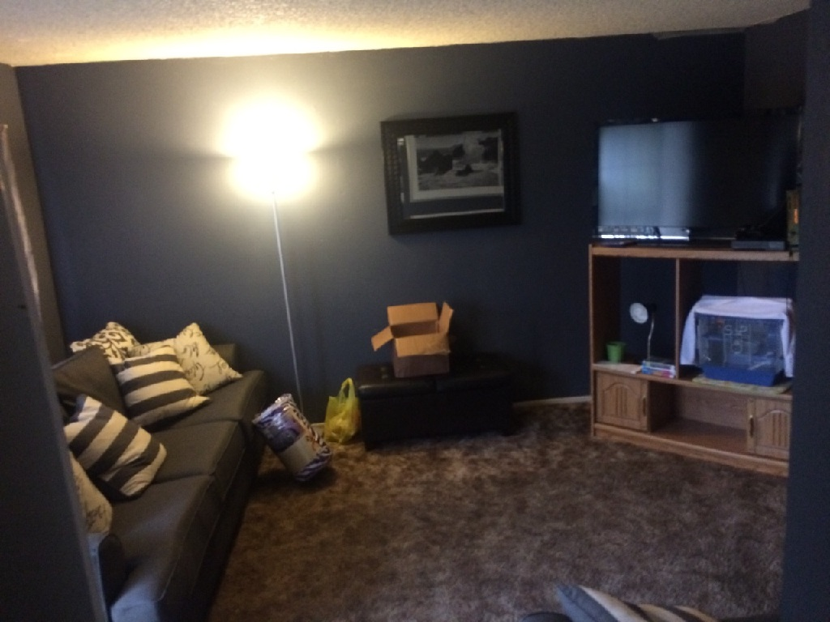
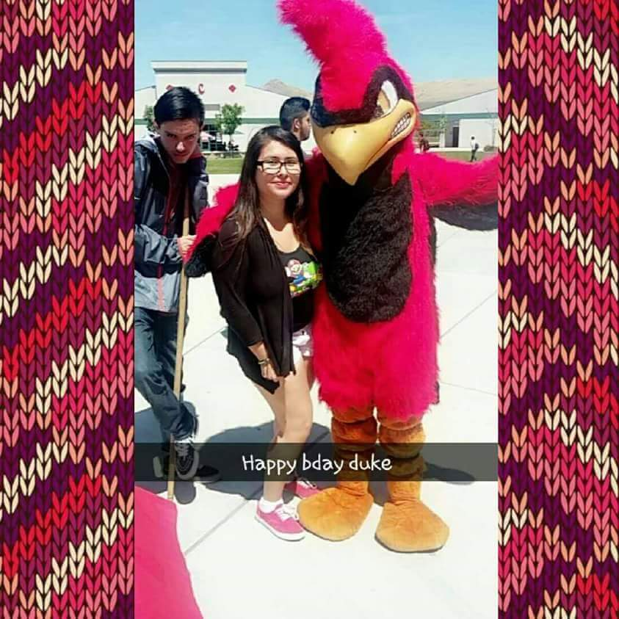
About me
My name is Alexis Romero am currently living in a apartment with a roommate in porterville as am attending high school here
My hobbies are hiking, drawing, and watching anime
I was born in porterville and moved to Lindsay untill I was 6 years old

Slide 3
Clubs and activities: Anime club
During my years at Lindsay High school i participated in many events and after school activities for one , the Lindsay High School's Anime Club.
The word "Anime" is the abbreviated pronunciation of "animation" in Japan
When i take apart in anime club it was always just my one way to socialize with people who share the same interest in me and one friday of every week was the one time i could discuss about anime without questions like “what's that”

Slide 4
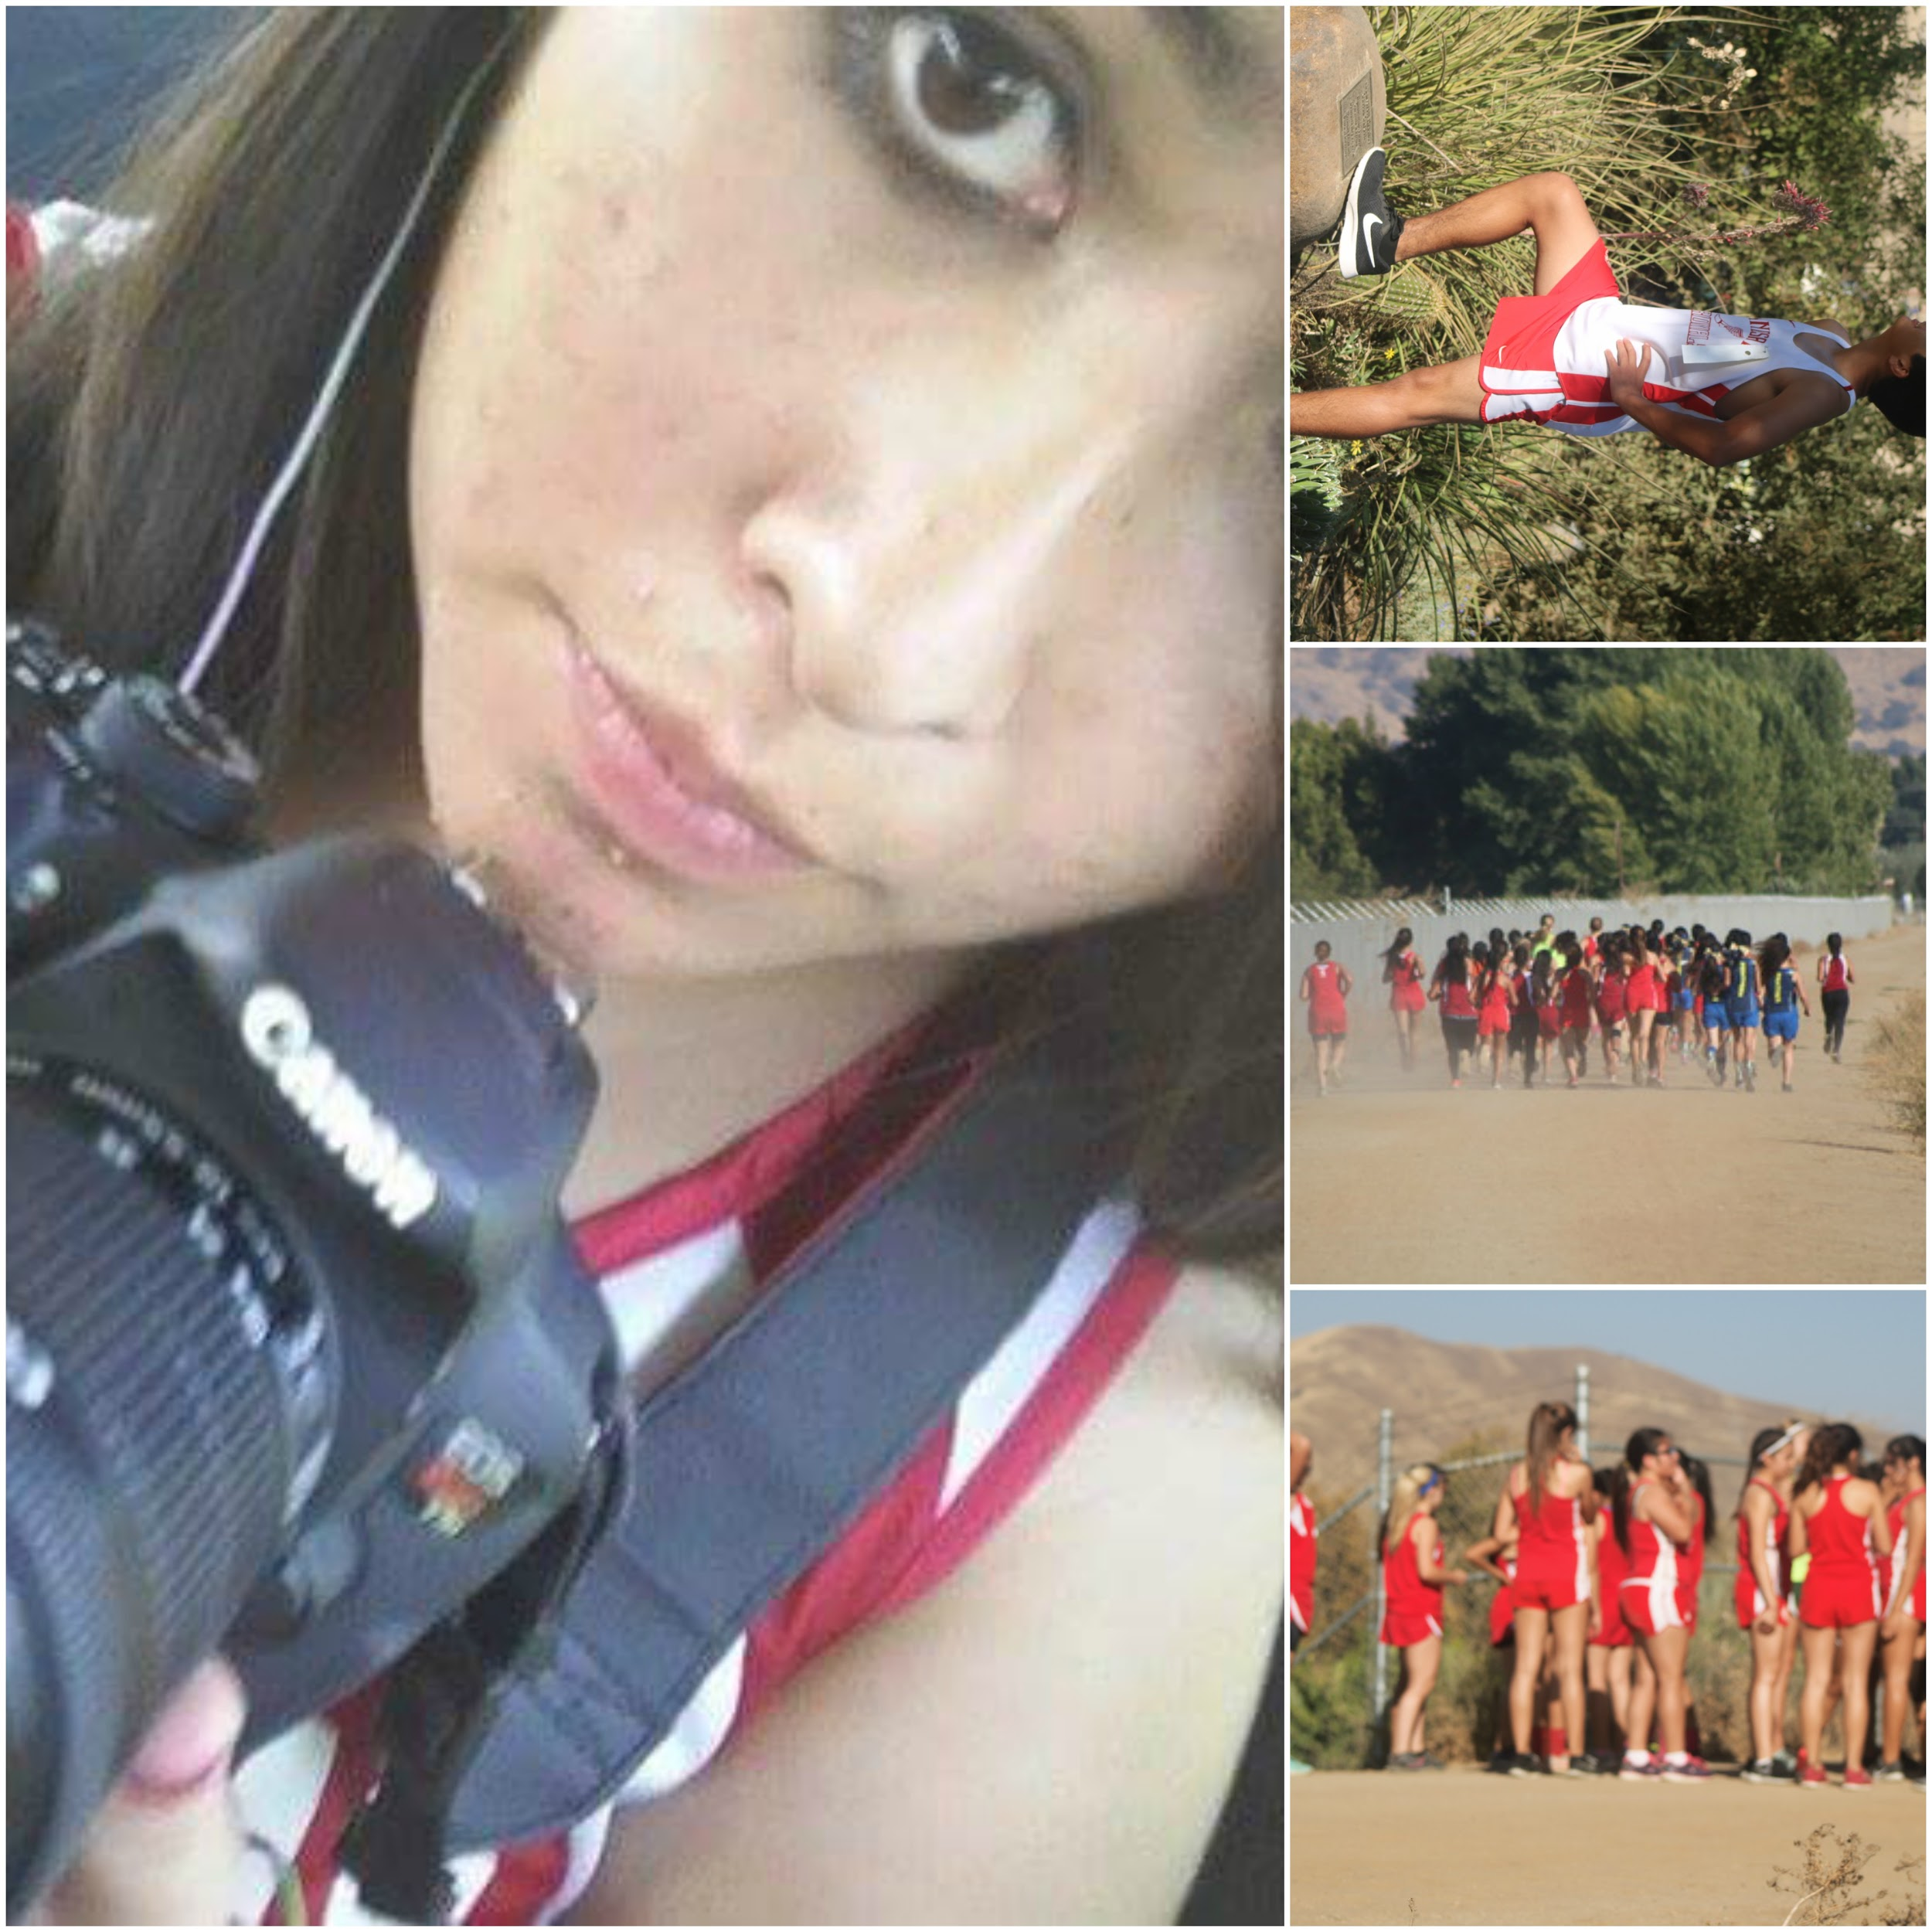
Clubs and activities: cross country
I was in the team for 3 years (freshmen, sophomore and my last year in high school)
Cross country is more of an escape from everyday life
We been to places around tulare county to LA

Slide 5
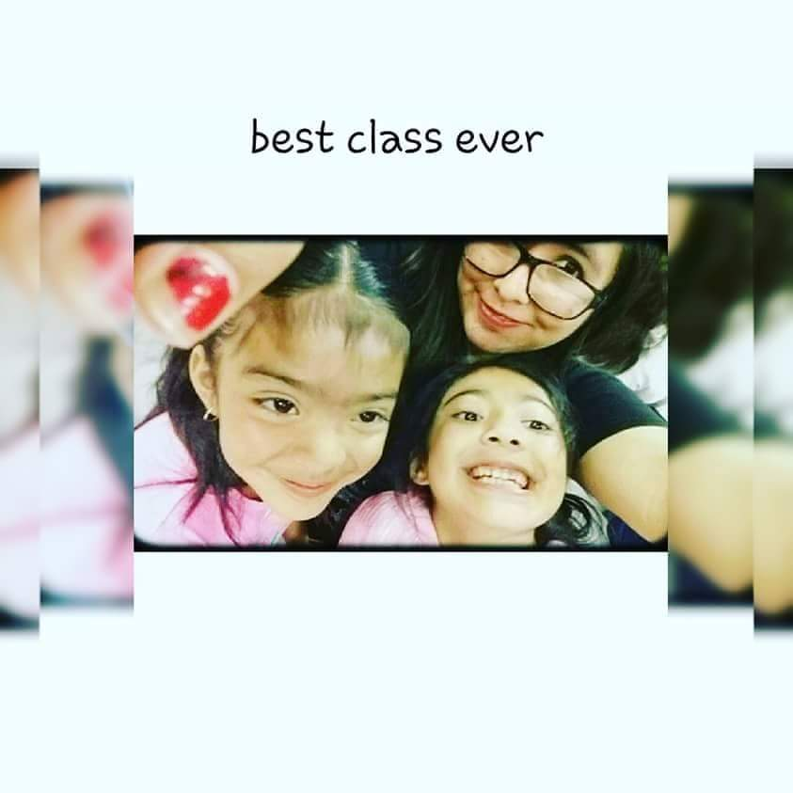
Job shadow
I went to washington to do a job shadow a kindergarten class
The whole day I helped their teacher (Mrs.peters) with math , english, and games and activities
The experience was wonderful being about to see the faces of little one’s as they learn.

Slide 6
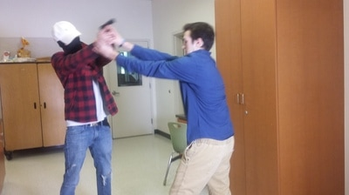
MY PATHWAY
DUKE TV is a way for the students of Lindsay high school to be informed about the new going around the school form the basketball team winning a game to the high school's football team winning state.
Our job as the information is to let the students know what's up every morning by producing and making videos .
We have a youtube channel and we upload videos and send them to the Lf's every morning with the basic information that every lhs learner needs to know before starting their morning off.
( if you want to see the youtube it is located in my website under duketv and click on the button below ): http://alexisromero559.weebly.com/

